Slide 1


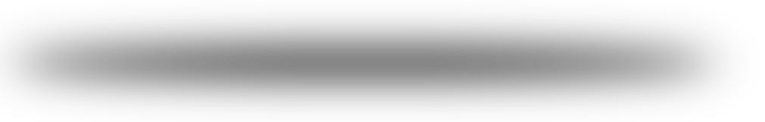
IMDb top Movies
Rawan Al-Qahtani
Ghadeer Alghamdi
Sypervised by: Dr.Mejdal Al-Qahtani

Slide 2

introduction
In this project we have used the IMDB movies dataset that was tacking from the website through web-scraping with beautiful soap. This data is for a 1000 movie containing (name-year released - show length –IMDB rating –audience votes – movie type –metascore –US gross
This data was used to create a module that can predict the IMDB rating from the other data(audience votes-year released - show length- metascore - US gross).
.

Slide 3

code sequence
Web scraping
Data cleaning
Models application
Data validation
Data visualizing
Predicting the top Movies

Slide 4

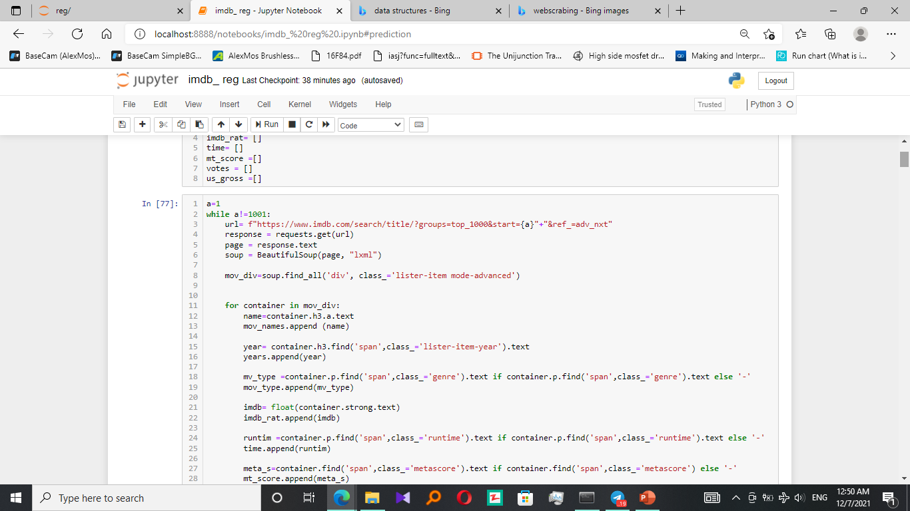
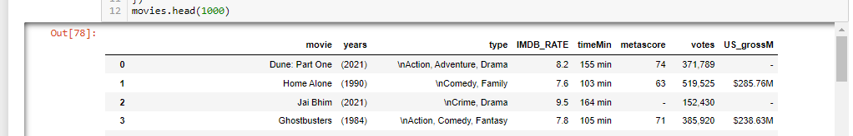
Web scraping
IMDB webpage was scraped to get dataset consist of 1000 movie with 8 categories for each.
this data was sorted into data-Frame

Slide 5



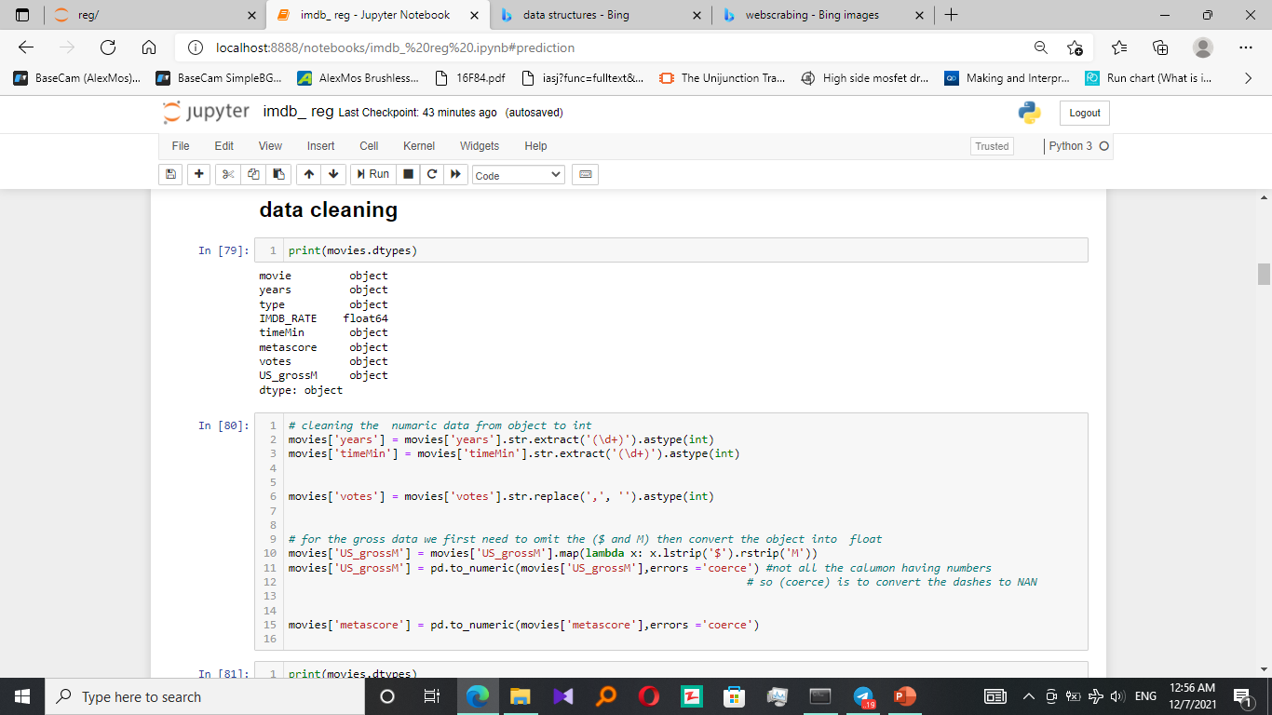
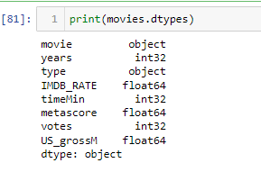
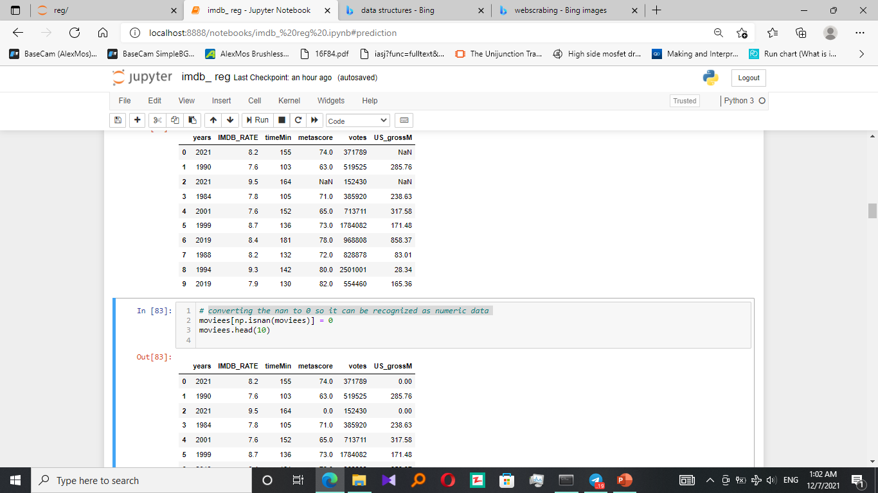
Data cleaning
cleaning the numeric data from object to int:
converting the nan to 0 so it can be recognized as numeric data:

Slide 6
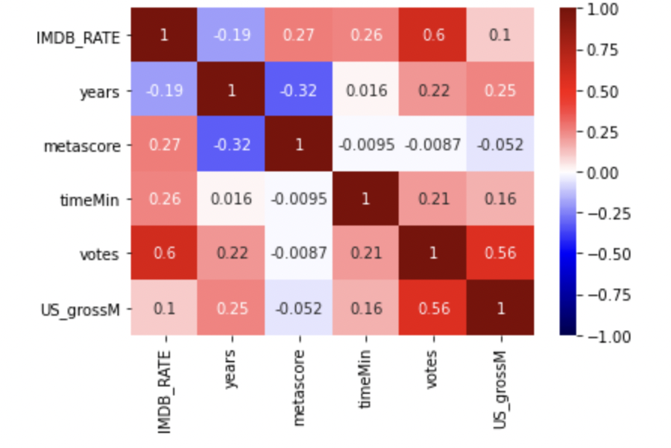
Data Correlation

Slide 7

Creating the prediction module
The Model | The R^2 | Testing | Cross Validation
Linear Regression | 0.591 | 0.541 | 0.534
Ridge Regression | 0.591 | 0.541 | 0.534
Polynomial regression | 0.551 | 0.627 | 0.544

Slide 8
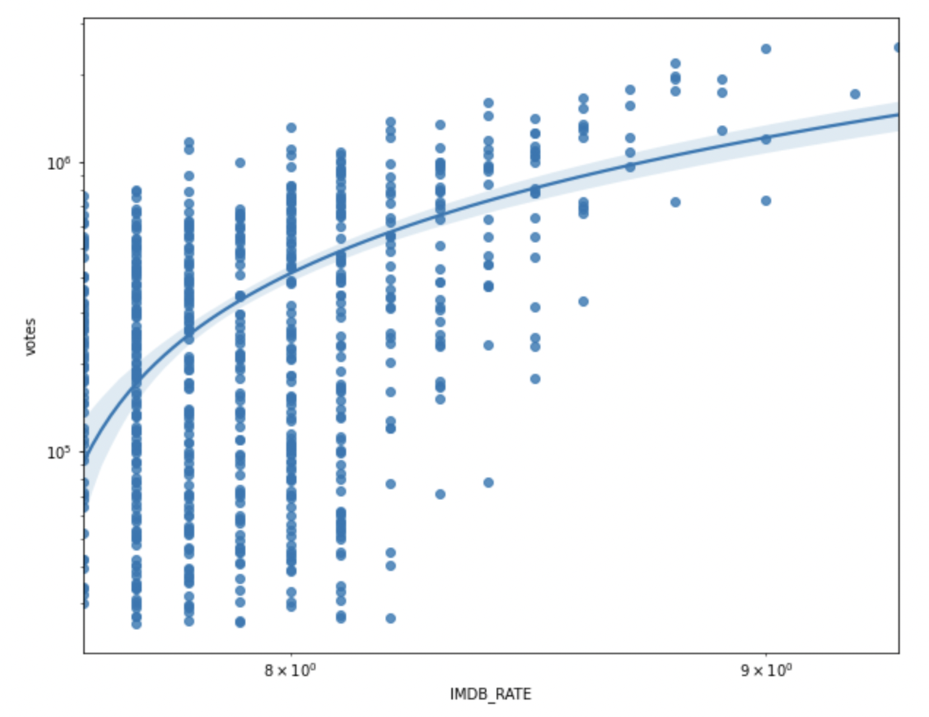
Data visualizing
Polynomial regression

Slide 9
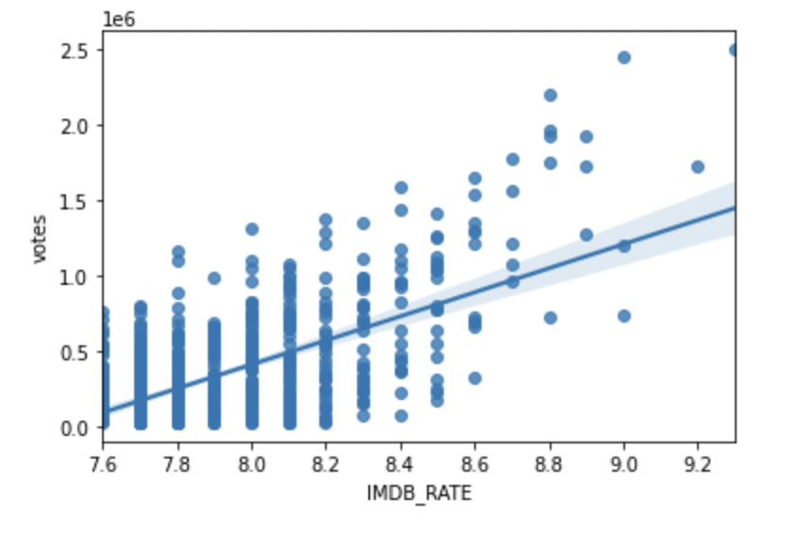
Data visualizing
Linear Regression

Slide 10
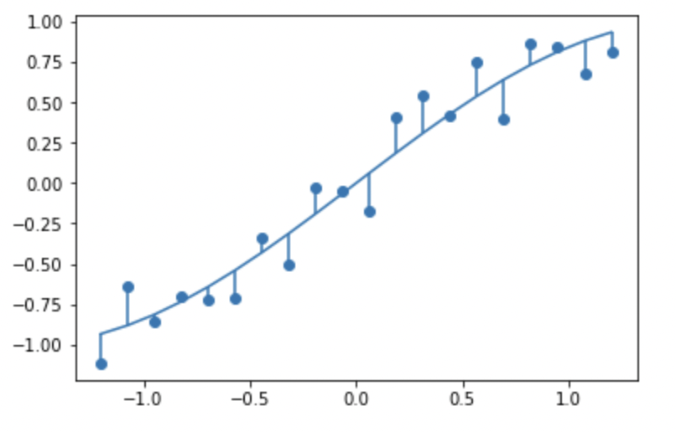
Plot residuals on a fitted model

Slide 11

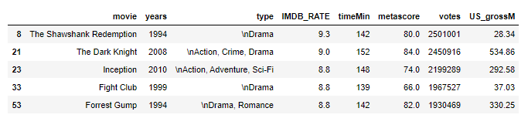
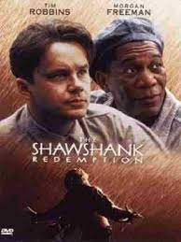


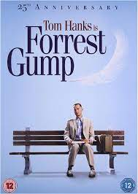
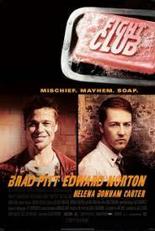
Predicting the IMDb rate to top 5 Movies
?

Slide 12
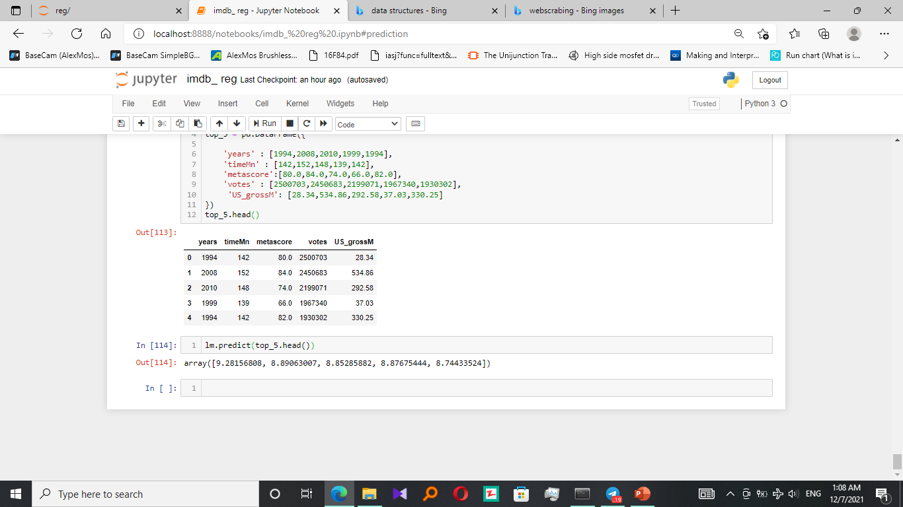
Predicting the IMDb rate to top 5 Movies
The real data
The input data to the prediction module
Comparing the output with the real data
The output data

Slide 13
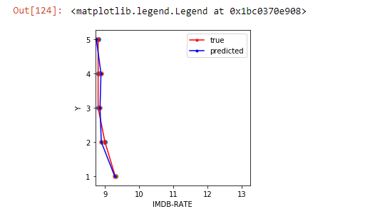

Predicting the IMDb rate to top 5 Movies
Comparing the output with the real data

Slide 14

Future Work
Apply all that on local dataset for local films since we got creative film makers!
Predict which category will be most watched so we can focuos on that! ☺

Slide 15


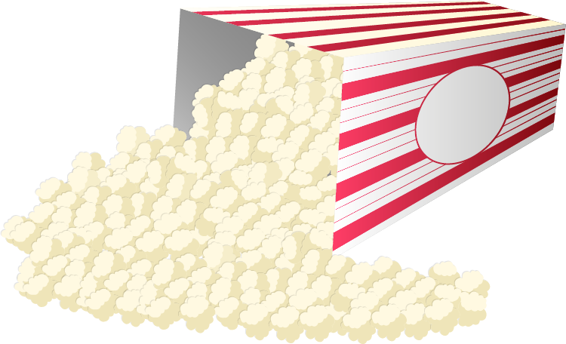


THANKS!

